Slide 1

ER+/HER2+ Breast Cancer HAS Different Metastatic Patterns and Better Survival Than ER-/HER2+ Breast Cancer
June 29, 2023

Slide 2
Introduction
Breast cancer is the most common cancer in women worldwide, with almost 2 million new breast cancer diagnoses each year.
Targeted therapy for breast cancer, especially metastatic disease, has been utilized for over 100 years.
The human epidermal growth factor receptor 2 (HER2) is a potential target in breast cancer.
HER2 is a protein that helps breast cancer cells grow quickly. Breast cancer cells with higher than normal levels of HER2 are called HER2-positive.

Slide 3
Methods
This study examined the metastatic pattern and prognosis of both estrogen receptor-positive (ER+)/human epidermal growth factor receptor 2-positive (HER2+) and estrogen receptor-negative (ER-) /HER2+ breast cancer.
Data was obtained from American College of Surgeon and American Cancer Society’s National Cancer Data Base (NCDB).
54,147 HER2 breast cancer patients diagnosed from 2010 to 2013 in the NCDB; the follow-up time was up to 71.72 months.

Slide 4
Variables
Age at diagnosis
Status of Estrogen receptor and progesterone receptor
Clinical stage
Tumor grade
Site of metastasis
treatment information
Surgery
Chemotherapy
hormone therapy
HER2-targeted therapy
radiotherapy.

Slide 5
Statistical Analysis
The variables were summarized by absolute and relative frequencies.
Differences between breast cancer subtypes (ER+/ HER2+, ER-/HER2+) with regard to metastatic sites (bone, brain, liver, lung, multiple, or no metastasis) were evaluated by a chi square test.
Kaplan-Meier survival curves were used to estimate the overall survival (OS) stratified by metastatic site for patients with ER+/HER2+ and ER-/HER2+ cancers.
Log-rank tests and univariate Cox proportional hazards model were performed to assess the difference in OS between ER+/HER2+ and ER-/HER2+ subtypes in all patients and in patients with different metastatic sites
Multivariate Cox regression analyses to estimate the effects of subtypes on OS while adjusting for other prognostic factors including age, stage, tumor grade, surgery, and systemic therapies. Results were regarded as statistically significant at P < .05

Slide 6
Results
Characteristics | ER+/HER2+ (N=37,922) | ER-/HER2+ (N=16,225)
Age at Diagnosis ≥ 50 years | 27,069 (71.38) | 12,282 (75.70)
Tumor Grade 1 | 2,762 (7.28) | 272 (1.68)
2 | 16,342 (43.09) | 3,762 (23.19)
3 | 18,818 (49.62) | 12,191 (75.14)
PR - Positive | 28,372 (74.82) | 904(5.57)
HER2-Targeted Therapy – Yes | 7,023 (18.52) | 2,893 (17.83)
Stage – I | 18,130 (47.81) | 7,118 (43.87)
II | 13,584 (35.82) | 5,711 (35.20)
III | 5,037 (13.28) | 2681 (16.52)
IV | 1,171 (3.09) | 715 (4.41)
Hormone Therapy – Yes | 33,202(87.55) | 1,374 (8.47)
Chemotherapy - Yes | 30865(81.39) | 14,079 (86.67)
ER+/HER2+ cancers had more PR positivity (74.82% vs. 5.57% in ER-/HER2+).
87.55% of patients with ER+/HER2+ cancers received hormone therapy.
Majority of patients with grade 1 tumor had ER+/HER2+ cancer.

Slide 7
Distribution of Metastatic Sites
 | Single Metastasis |  |  |  | Multiple metastasis | No Metastasis
 | Bone | Brain | Liver | Lung | Multiple metastasis
ER+/HER2+ | 552 | 16 | 188 | 119 | 360 | 36,687
ER-/HER2+ | 139 | 19 | 202 | 133 | 240 | 15,492
Compared to ER-/HER2+ breast cancers, ER+/HER2+ breast cancers were more likely to metastasize to bone and less likely to brain, liver, and lung (p<.0001)
The most frequent metastatic site was bone in ER+/HER2+ and Liver in ER-/HER2+

Slide 8
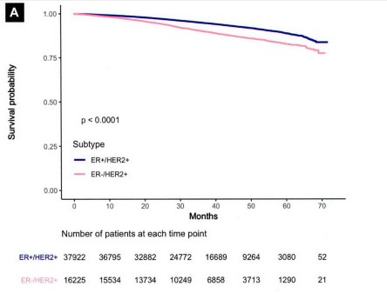
All Patients
Patients with ER-/HER2+ breast cancer had worse OS than ER+/HER2 cancer patients in all patients

Slide 9
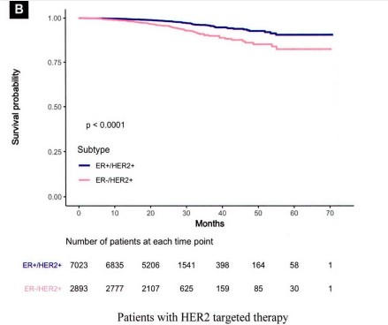
HER2 targeted therapy
Patients with ER-/HER2 breast cancer had worse OS than ER+/HER2 cancer patients in patients who received HER2 targeted therapy

Slide 10
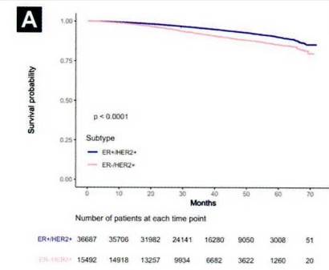
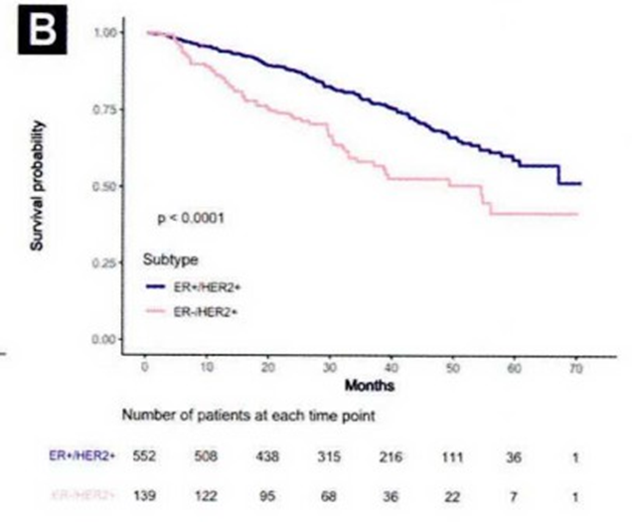
No metastasis and Bone metastasis
For no metastasis, patients with ER-/
HER2+ breast cancer had worse overall survival
For bone metastasis, patients with ER-/
HER2+ breast cancer had worse overall survival

Slide 11
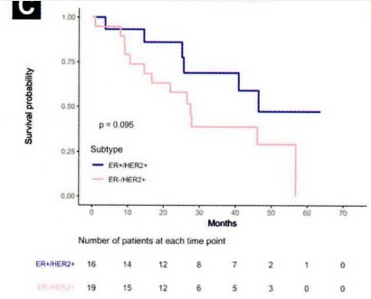
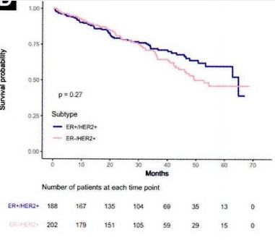
Brain and Liver metastasis
For brain metastasis, patients with ER-/
HER2+ breast cancer had worse overall survival
For liver metastasis, patients with ER-/
HER2+ breast cancer had worse overall survival

Slide 12
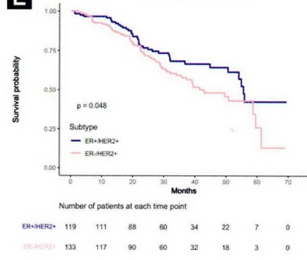
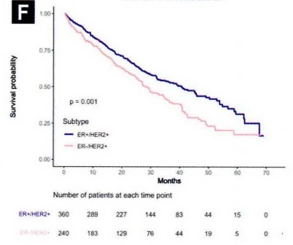
Lung and multiple metastasis
For lung metastasis, patients with ER+/
HER2+ breast cancer had worse overall survival
For multiple metastasis, patients with ER+/
HER2+ breast cancer had worse overall survival

Slide 13
Univariate and Multivariate Cox Analysis
Characteristics | Univariate Analysis |  | Multivariate Analysis
 | HR (95% CI) | P | HR(95% CI) | P
All patients | 0.57 (0.53-0.60) | <.0001 | 1.00 (0.91 – 1.09) | .96
Patients received her2 targeted therapy | 0.41 (0.33-0.51) | <.0001 | 0.97 (0.68 – 1.39) | .88
Metastatic site
No metastasis | 0.58 (0.54-0.62) | <.0001 | 1.01 (0.91 – 1.12) | .88
Bone | 0.51 (0.38 – 0.69) | <.0001 | 0.54 (0.37 – 0.79) | .0015
Brain | 0.45 (0.17 – 1.18) | .10 | 0.40 (0.07 – 2.38) | .31
Liver | 0.82 (0.58 – 1.17) | .27 | 1.41 (0.91 – 2.18) | .12
Lung | 0.67 (0.44 – 1.00) | .049 | 1.33 (0.79 – 2.24) | .29
Multiple | 0.69 (0.56 – 0.86) | .0011 | 0.95 (0.73 – 1.24) | .36
Multivariate analysis was adjusted for age, stage, tumor grade, surgery, chemotherapy, HER2-targeted therapy and hormone therapy.
In bone metastasis, Patients with ER+/HER2+ cancer had a 46% lower hazard rate than patients with ER-/HER2+ cancer

Slide 14
Discussion
ER+/HER2+ patients were noted to have a higher rate of bone metastasis than ER-/HER2+ patients.
Patients with ER-/HER2+ cancer had significantly more liver metastasis as well as higher rates of metastasis to brain and lung.
Patients with ER+/HER2+ breast cancer have better OS.
This is similar to findings in other studies (Garcia Fernandez et al, Molnar et al, Lobbezoo et al).

Slide 15
Limitations and Weaknesses
Issues of data entry and completeness of the treatment record.
From 2010 to 2013, only 18% received HER2+ targeted therapy. This would be an error.
Relatively short follow up time
Did not justify the use of the Cox proportional hazards model

Slide 16
References
Arciero, C. A., Guo, Y., Jiang, R., Behera, M., O’Regan, R., Peng, L., & Li, X. (2019). ER+/HER2+ breast cancer has different metastatic patterns and better survival than ER−/HER2+ breast cancer. Clinical breast cancer, 19(4), 236-245.
Lobbezoo DJ, van Kampen RJ, Voogd AC, et al. Prognosis o f metastatic breast cancer subtypes: the hormone receptor/HER2-positive subtype is associated with the most favorable outcome. Breast Cancer Res Treat 2013; 141:507-14.
Molnar LA, Molnar BA, Vizkeleti L, et al. Breast carcinoma subtypes show different patterns of metastatic behavior. Virchows Arch 2017; 470:275-83.
Sanpaolo P, Barbieri V, Genovesi D. Prognostic value o f breast cancer subtypes on breast cancer specific survival, distant metastases and local relapse rates in conservatively managed early-stage breast cancer: a retrospective clinical study. Eur J Surg Oncol 2011; 37:876-82

